Slide 1
Comprehensive Digital Marketing
Project Work on Sunfeast

Slide 2
TEAM MEMBERS:
Kushwant Geddada [Team Leader]
Priyanka Kannepalli
Korada Aashik
Khaja Kausar
Kandipilli Triveni

Slide 3

Brand: Sunfeast

Slide 4

Part 1: Brand study, Competitor Analysis & Buyer’s/Audience’s Persona
COMPANY/TOPIC for project: SUNFEAST
In July 2003, ITC made a foray into the biscuits market by launching the Sunfeast range of biscuits. Since then, Sunfeast biscuits have always stood for quality and are known for offering innovative and wholesome biscuits. Sunfeast connotes happiness, contentment, satisfaction and pleasure.
Brand Website: https://www.sunfeastworld.com/
Brand colours: Orange, Red, Yellow and White
Brand Logo:
Mission/Values: ITC’s Vision is to sustain ITC's position as one of India's most valuable corporations through world class performance, creating growing value for the Indian economy and the Company's stakeholders and Mission is to enhance the wealth generating capability of the enterprise in a globalising environment, delivering superior and sustainable stakeholder value.
The brand's tagline: Tagline of Sunfeast is “Spread the Smile”

Slide 5
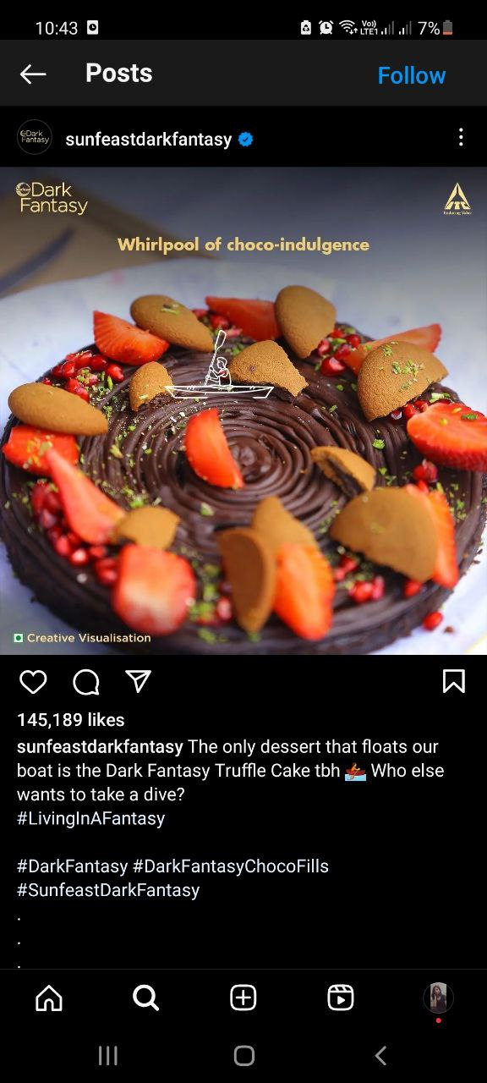
COMPANY/TOPIC for project: SUNFEAST
USP: Their unique selling proposition is that they offer taste and nutrition in every bite. Also their packaging, impeccable quality and different varieties of their products. Celebrity endorsement is included as well.
Analyse Brand Messaging:
In July 2003, ITC entered into Biscuits market with the Sunfeast range of Glucose, Marie and cream biscuits. The brand connotes to happiness, contentment, satisfaction and pleasure since its mascot Sunny and slogan spread the smile. In a span of 6 years Sunfeast has launched many new varieties and has its presence in almost all types of biscuit categories. It is Attractive, innovative and aesthetic. Each product has it’s own particular color theme and there and fun advertisements. They also show different variety of recipies in which customers can use their product.
Example: https://www.instagram.com/reel/CuHGYEJB7KD/?igshid=MzRlODBiNWFlZA==
Examine the brand’s tagline: Sunfeast is a brand in the snacks food segment.Tagline of Sunfeast is “Spread the Smile” ITC entered the biscuits market with sunfeast brand in July 2003. . Tagline of Sunfeast Glucose Biscuits is: “Jo de jitne ki sakti” i.e. “one that gives the power to win”.

Slide 6

Part 1: Brand study, Competitor Analysis & Buyer’s/Audience’s Persona
Competitor Analysis
Competitor 1: Parle Products
Parle Products Limited was established in 1929 and it is worth around US$ 450 million. Parle Products Limited is one of the topmost manufacturers of confectionery and biscuits in India. Parle-G, one of the brands of Parle Products Limited, is one of the highest selling biscuit brands in India. Other popular brands of Parle Products Limited are Mango Bite, Sixer, Melody, and Hide and Seek. The name of the company is a symbol of great taste, nutrition, and quality. Logo:
Website: https://www.parleproducts.com/
USP: One of India’s most trusted, affordable and most sold foods brand.
Includes a wide variety of products, has precise categorisation, creative display of products.
Communication: Animated video promotion, User generated content, Instagram video challenges

Slide 7

Part 1: Brand study, Competitor Analysis & Buyer’s/Audience’s Persona
Competitor 2: Britannia Industries
Britannia Industries Limited is an Indian Multinational FMCG company specialised in food industry, part of the Wadia Group headed by Nusli Wadia. Founded in 1892 and headquartered in Kolkata, it is one of India's oldest existing companies and best known for its biscuit products.
Logo:
Website: https://www.britannia.co.in/
USP: India’s very own bakery and dairy products brand that is trusted for its quality. It is very Informative , Attractive, and has a Fun visualisation presented of their products.
Communication: Celebrity endorsement, recipies, fun animations

Slide 8

Part 1: Brand study, Competitor Analysis & Buyer’s/Audience’s Persona
Competitor 3: Unibic Foods
UNIBIC Foods India Pvt. Ltd is one of the premium cookies manufacturing company in the country. The company is subsidiary of UNIBIC Australia which is a niche player in Australia with forty plus brands. UNIBIC came to India in 2004. Over the years, UNIBIC has grown its range to over 40 variants and has been regularly introducing fresh & unique flavors to cookie connoisseurs worldwide. Headquartered in Bangalore, UNIBIC is known for its rich and flavorsome cookies that take a bite of the premium cookie market.
Logo:
Website: https://www.unibicfoods.com/
USP: The USP (Unique selling proposition) of the organization is its premium quality as the company has never competed with its counterparts when it comes to the aspect of pricing. It has Wide variety of flavours and good Categorisation.
Communication: Relatable content, Celebrity endorsements, Collaborations, Interactive

Slide 9
Part 1: Brand study, Competitor Analysis & Buyer’s/Audience’s Persona
Buyer's/Audience's Persona: Clearly define the target audience for the chosen brand. Consider demographics, psychographics, behaviors, and interests.
The target audience for Sunfeast could be as follows:
Demographics:-
Age Range: 5 – 60 years (Children, Adults and Old)
Gender: Any gender
Children: Yes
Marital Status: Unmarried/ Married

Slide 10
Location: Urban and Rural areas (excluding very secluded or technologically backward places)
Income: 2,00,000 per annum – 30,00,000 per annum
Education: At least 5th grade+
Psychographics:
Information: Ads, Television, Banners, Posters, Window showcasing, Display, Instagram, Grocery delivery sites online, Retail stores
Personal Values: Appreciation for food, Want to try variety of foods, Quality oriented and Money saving.
What drives their decision making: Quality of the products, Easy availability, Low cost, Attractive packaging, the reason of need of the product, Ingredients, More shelf life, Hygiene
Lifestyle: Housewives, Family members, Children, Employees

Slide 11
Part 2: SEO & Keyword Research
SEO Audit: Do an SEO audit of the brands website
Keyword Research: Define Research Objectives, Brainstorm Seed Keywords, Utilize Keyword Research Tools (SEMrush or Moz Keyword Explorer),Analyze Competitor Keywords, Long-tail Keyword Exploration (specific, longer phrases) that align with the research objectives and have lower competition but higher conversion potential.
On page Optimization: Meta Tag optimization & content optimization
Reflect on the process of conducting keyword research and the SEO recommendations provided.
Document the challenges faced during the research and analysis phase, as well as the key insights gained from the keyword research process.

Slide 12
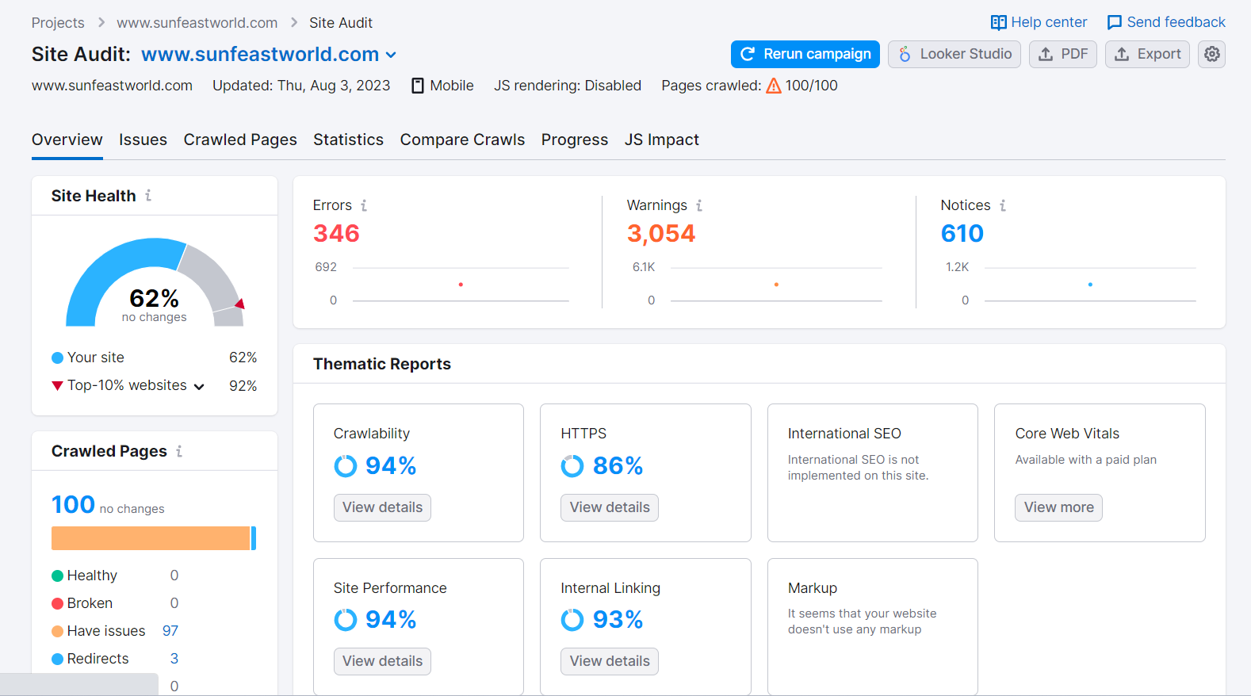
Seo Audit:
Website: https://www.semrush.com/

Slide 13
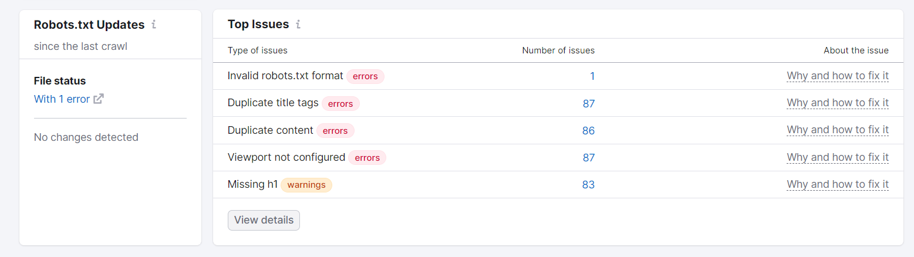
SEO Audit Summary:
The site audit for https://www.sunfeastworld.com/ indicates that the site's health is rated at 62%.
The crawlability and HTTPS implementation of the website are at a commendable 94%, ensuring smooth accessibility and security.
The site performance is at 94% and the internal linking is at 93%.
There are enormous number of errors amounting to 346 and 3054 warnings detected.
Furthermore this site also has notices upto 610 and still counting.
Peeking into Crawled pages, we found out that the site was facing 97 issues and only 3 redirects.
Additionally, going through thematic reports, international SEO is not implemented on this site.
The above picture has the Top issues mentioned that need critical attention.

Slide 14
Keyword Research:
Objective of Keyword Research for Sunfeast Brand:
•Improve organic search visibility
•Increase organic traffic
•Understand user intent
•Conduct competitor analysis
•Plan and create relevant content
•Target local SEO
Brainstorm seed keywords:
Seed keywords are the foundation of your keyword research. These are general, broad terms that are related to the business or industry. Here are some seed keywords for Sunfeast:
1. Biscuits
2. Cookies
3. Cream
4. Cakes
5. Noodles
Website: https://www.semrush.com/

Slide 15
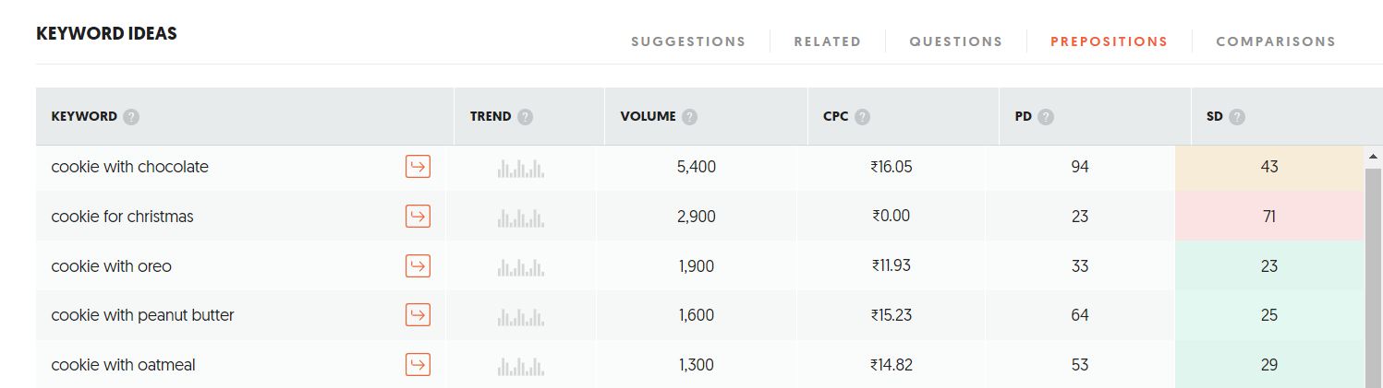
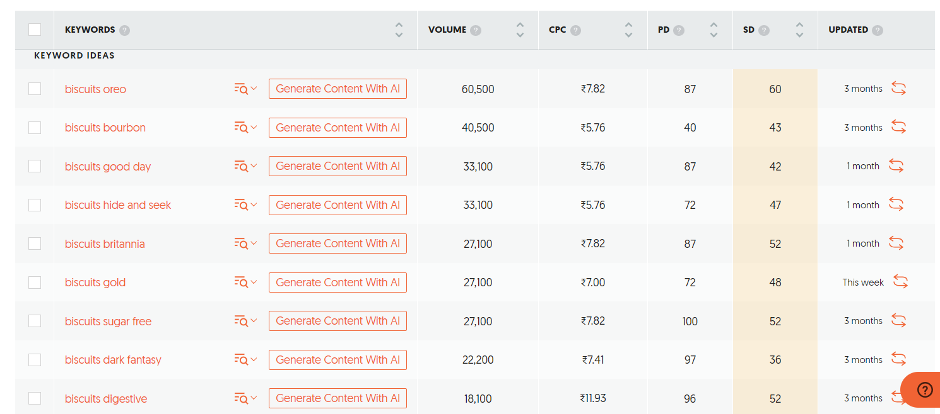

Slide 16
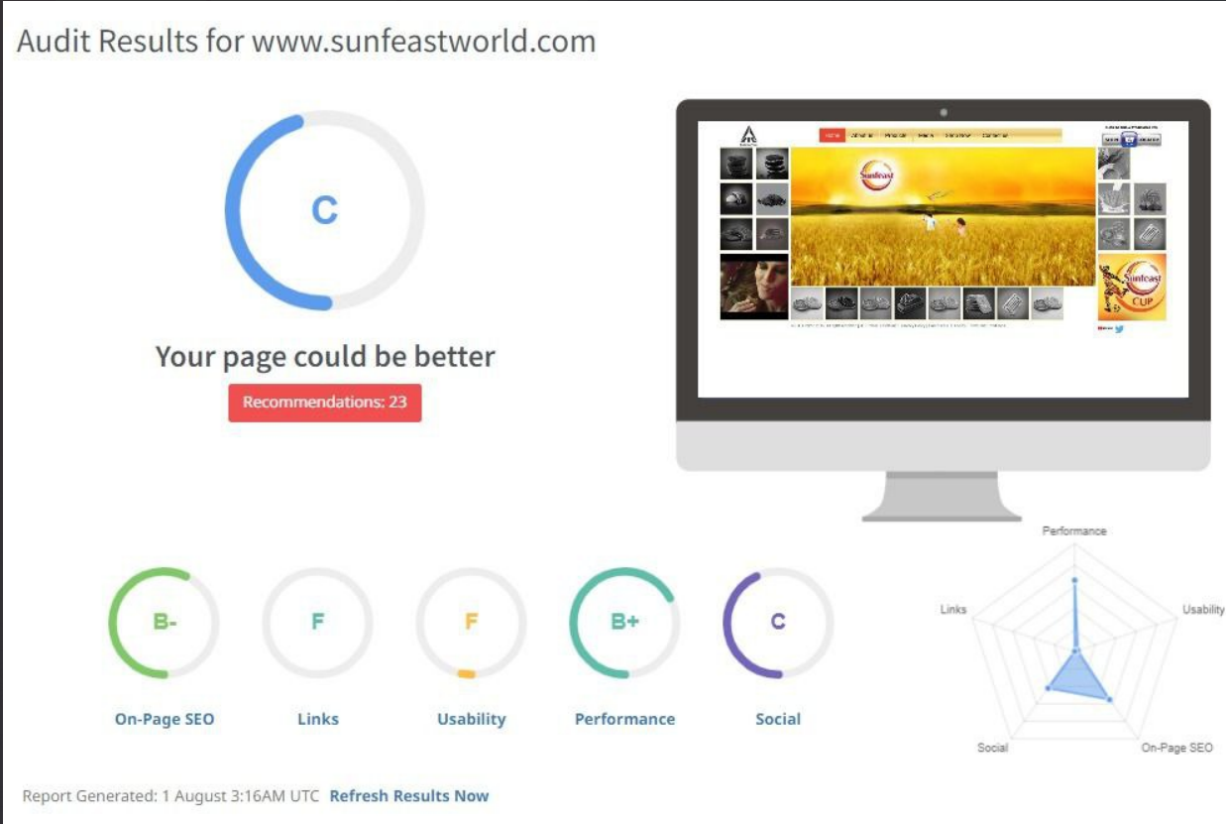
On Page Optimisation:
Website: https://www.seoptimer.com/

Slide 17
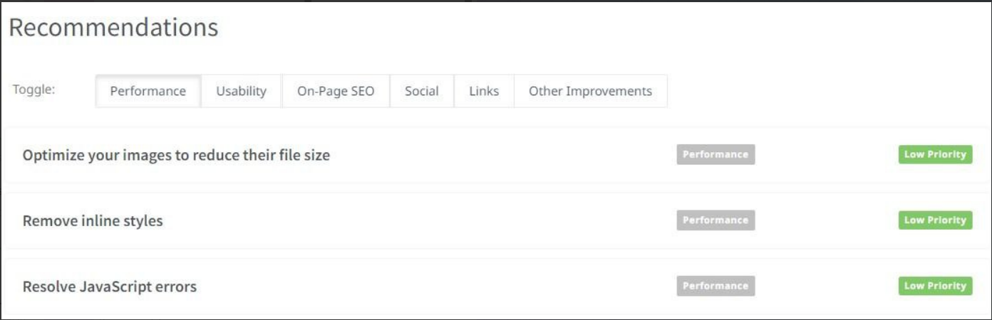
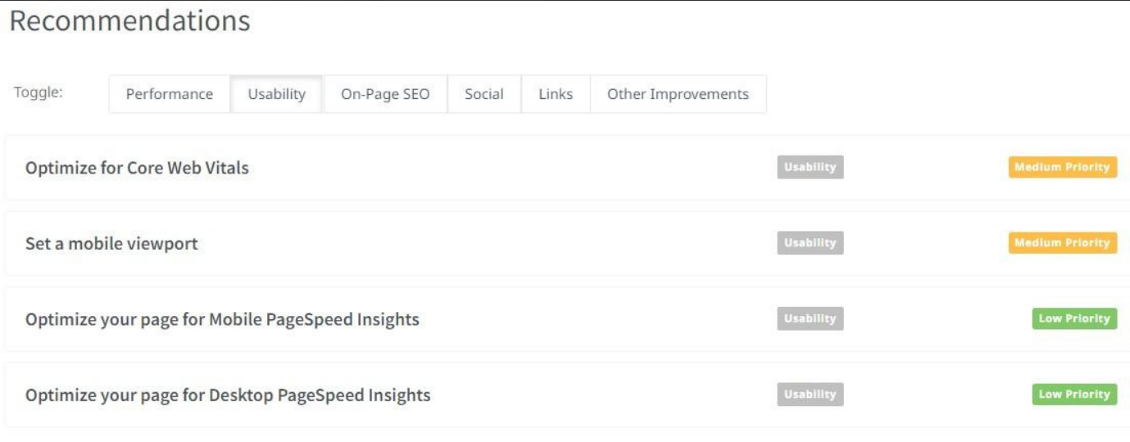
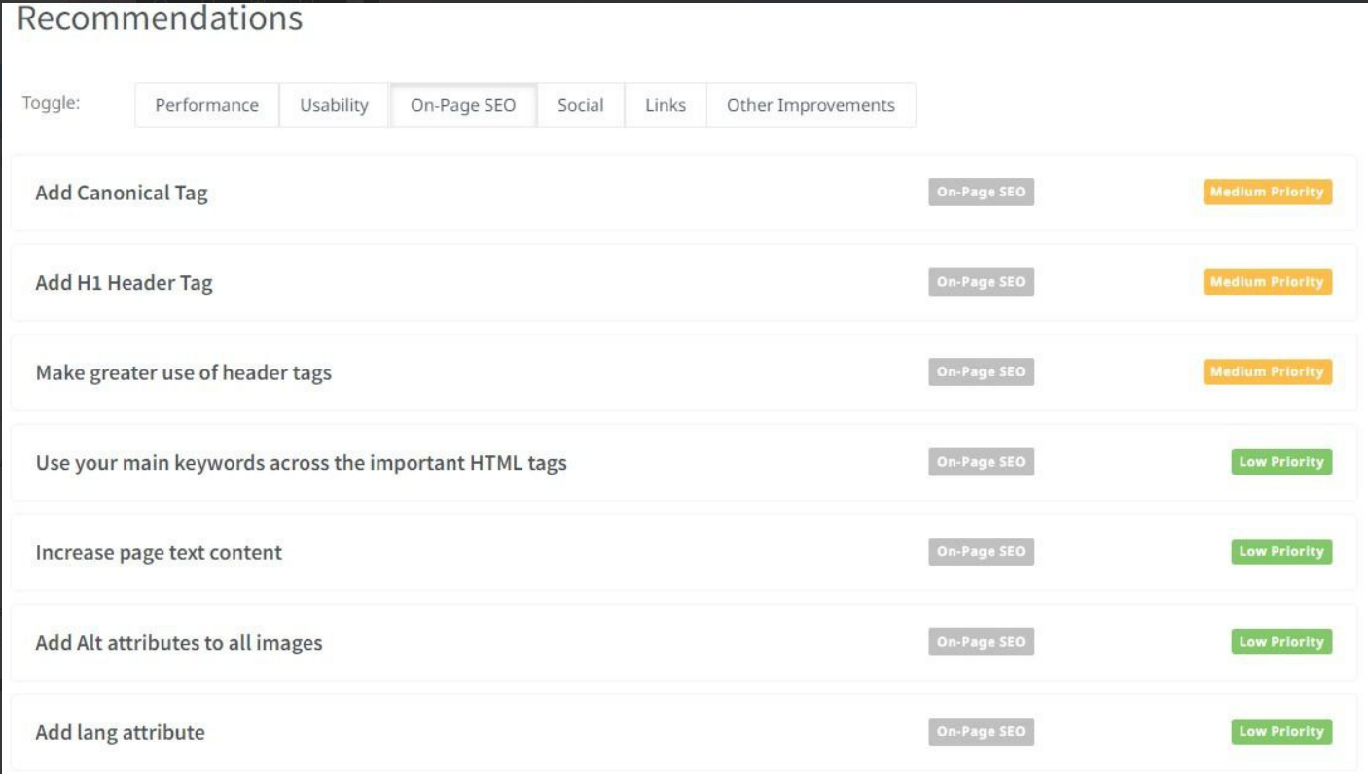

Slide 18
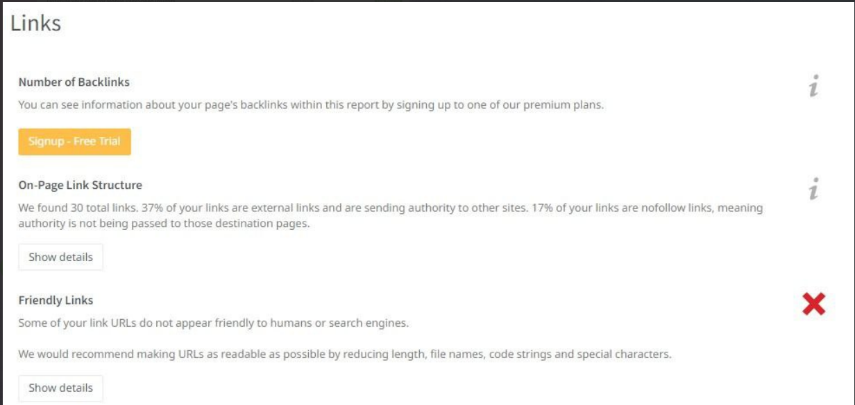
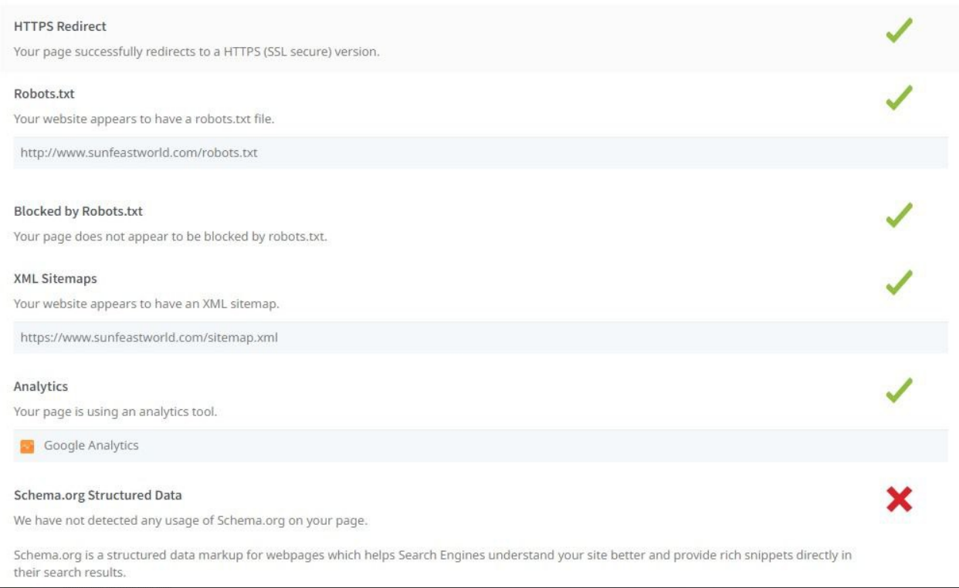

Slide 19
Page Optimization Summary:
Some of the recommendations include:
- "Optimize for Core Web Vitals" under the "Usability" toggle, which indicates that improving the website's usability is a medium priority.
- "Set a mobile viewport" under the "Usability" toggle, which is also a medium priority.
- "Add Canonical Tag" under the "On-Page SEO" toggle, which is a medium priority as well.
- "Add H1 Header Tag" under the "On-Page SEO" toggle, which is a medium priority.
- "Make greater use of header tags" under the "On-Page SEO" toggle, which is a medium priority.
- "Optimize your images to reduce their file size" under the "Performance" toggle, which is a low priority.
- "Optimize your page for Mobile Page Speed Insights" under the "Usability" toggle, which is a low priority.
- "Optimize your page for Desktop Page Speed Insights" under the "Usability" toggle, which is a low priority.
These recommendations provide guidance on how to improve the website's performance, usability, on-page SEO, and other aspects. The user can use these suggestions to enhance their website's functionality and optimize it for better performance.

Slide 20
Part 3: Content Ideas and Marketing Strategies
Content Idea Generation and strategy:
A content calendar has been created that shows the events and campaigns that company will follow through the entire month of August in which a few promotional campaigns were followed through Instagram stories, post promotions, reels, e-mail campaigns, etc.
Objectives:
Consistency
Planned schedule
Time management
Improved interpersonal skills
Content variation

Slide 21
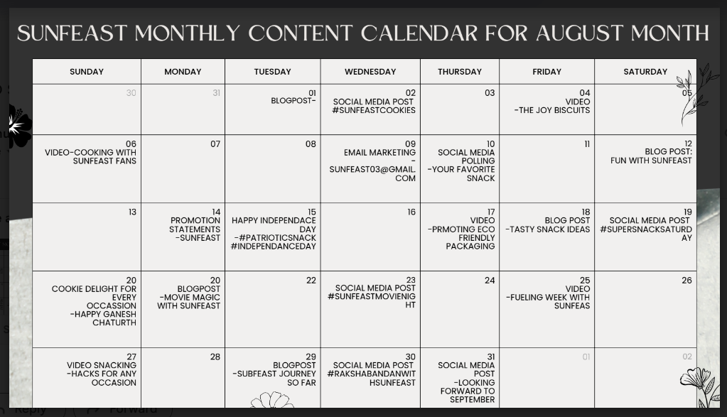
Part 3: Content Ideas and Marketing Strategies

Slide 22
Part 4: Content Creation and Curation (Post creations, Designs/Video Editing, Ad Campaigns over Social Media and Email Ideation and Creation)
Post Creation:
Select Content Categories: Identify three different content formats relevant to the chosen topic or industry. Research and Brainstorm: Research trending topics, industry news, or audience interests within each category. Brainstorm ideas for social media posts that align with each category. Do note that 1 content format has to be video and additionally 3 stories/status are to be created.
Format 1: Instagram Story
Format 2: Designs/ Video Editing
Format 3: Facebook ad campaign

Slide 23
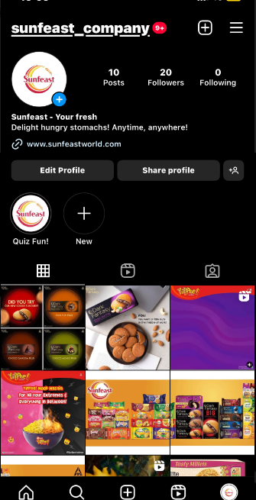
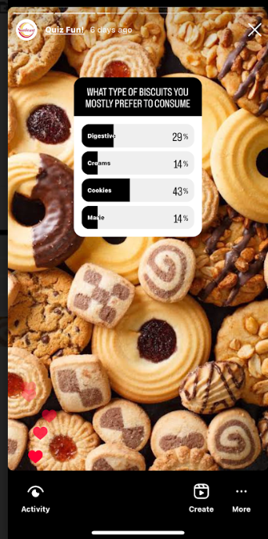
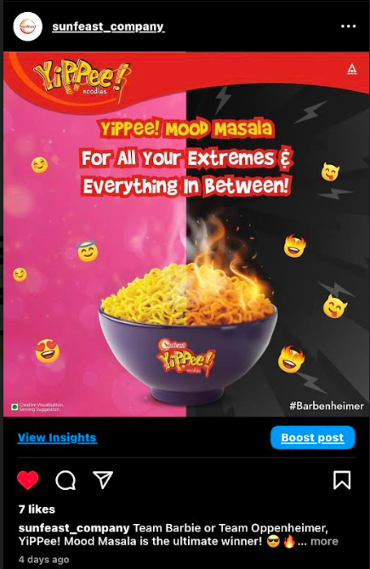
Part 4: Content Creation and Curation (Post creations, Designs/Video Editing, Ad Campaigns over Social Media and Email Ideation and Creation)
Instagram page
Instagram Story Poll
Instagram post creation

Slide 24
Part 4: Content Creation and Curation (Post creations, Designs/Video Editing, Ad Campaigns over Social Media and Email Ideation and Creation)
Significance of Instagram Story and Post creation:
1. Increased brand awareness: Instagram has over 1 billion active users, making it an excellent platform to reach a large audience and increase brand visibility.
2. Enhanced engagement: Instagram allows businesses to interact with their followers through likes, comments, and direct messages, fostering engagement and building stronger relationships with customers.
3. Targeted advertising: Instagram’s advertising platform allows businesses to target specific audiences based on demographics, interests, behaviors, and more, increasing the chances of reaching potential customers.
4. Visual storytelling: Instagram is a visual platform, making it an ideal place for businesses to showcase their brand story through visually appealing content.
5. E-commerce integration: Instagram offers various features, such as product tags and shoppable posts, that allow businesses to sell products directly on the platform, simplifying the purchasing process for customers.
Format 1: Instagram story and Post creation
Aim: To leverage customer engagement
Idea: To increase customer base by posting relevant and informative content about Sunfeast.
Link: Click Here

Slide 25
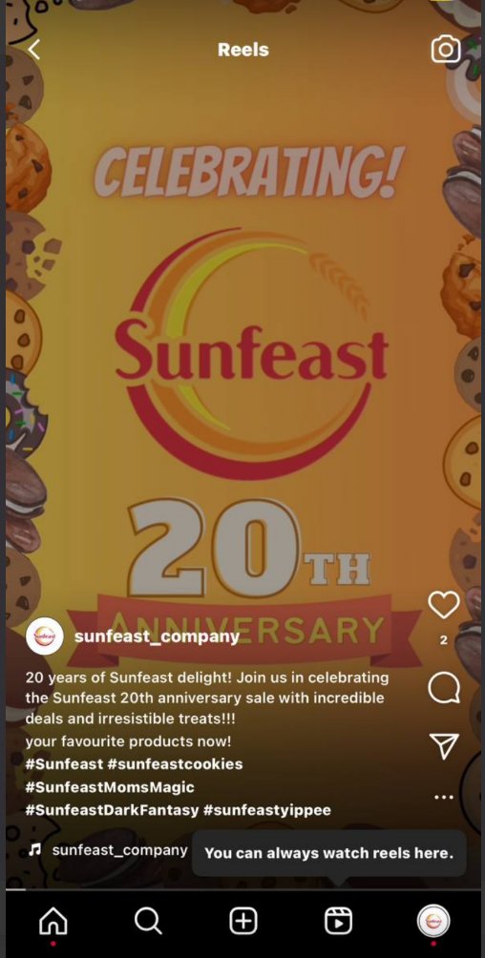
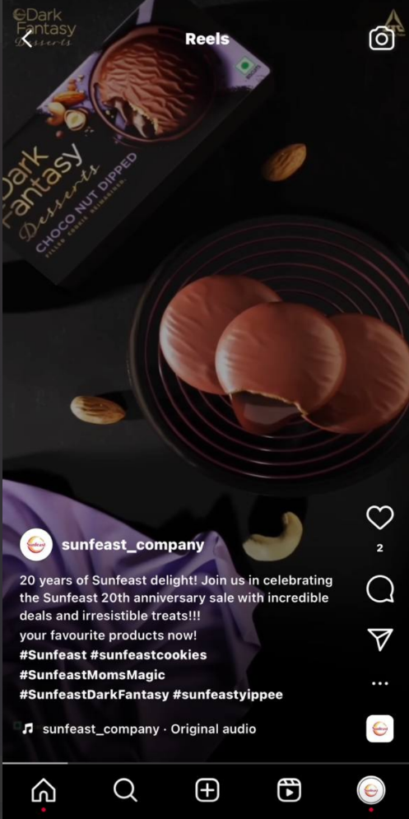
Part 4: Content Creation and Curation (Post creations, Designs/Video Editing, Ad Campaigns over Social Media and Email Ideation and Creation)
Format 2: Design and Video Editing
Aim: To Increase Sunfeast Brand Endorsement
Date: 2nd August, 2023
Idea: Sunfeast Company has introduced it’s latest product line and we made a video promoting the sale of the various latest products on the occasion of it’s 20th Anniversary offers.
Topic: Sunfeast 20th Anniversary Offer
Links: Click here for Video
Click here for instagram post
Caption: 20 years of Sunfeast Delight! Join us in celebrating the Sunfeast 20th Anniversary sale with Incredible deals and Irresistible treats!!!
🍪🍾✨💫🥳 Grab your favourite products now.

Slide 26
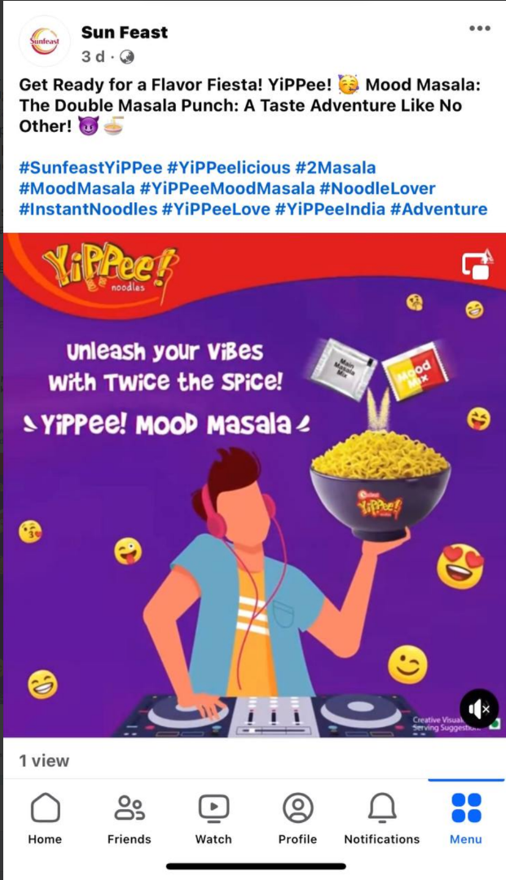
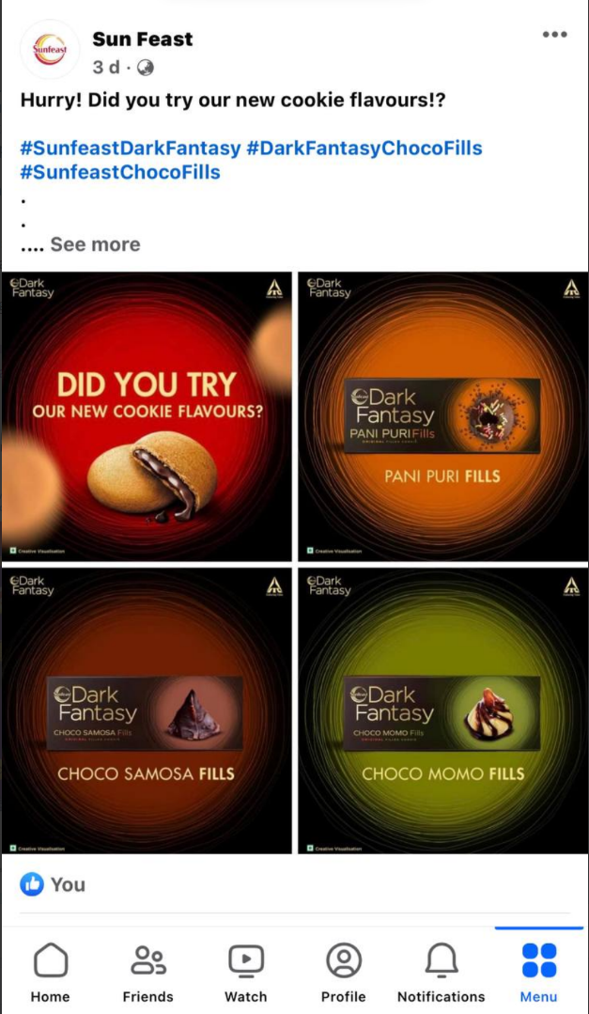
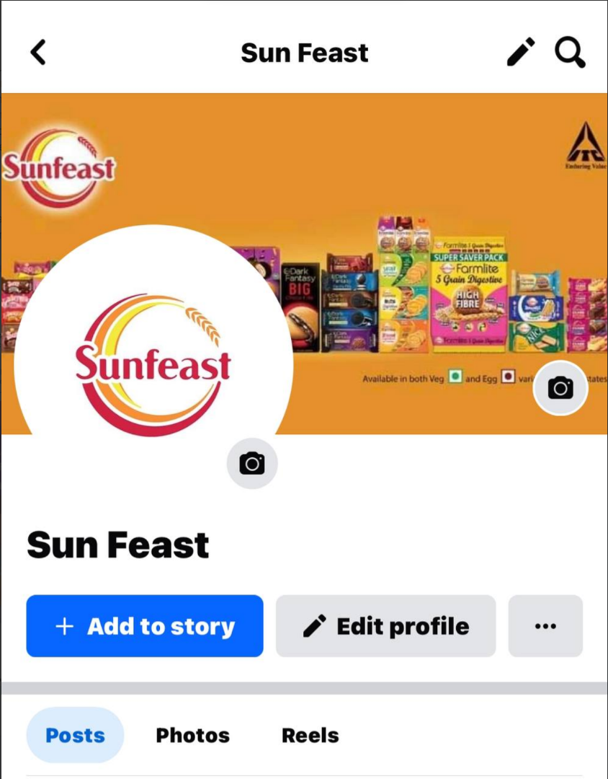
Part 4: Content Creation and Curation (Post creations, Designs/Video Editing, Ad Campaigns over Social Media and Email Ideation and Creation)
Format 3: Facebook Ad Campaign

Slide 27
Part 4: Content Creation and Curation (Post creations, Designs/Video Editing, Ad Campaigns over Social Media and Email Ideation and Creation)
Objectives of Facebook ad campaign:
Establish a Facebook presence.
Engage the audience.
Drive traffic to the website.
Foster interaction and trust.
Use Facebook ads strategically.
Analyze performance and optimize.
Link of Facebook page: Click Here

Slide 28
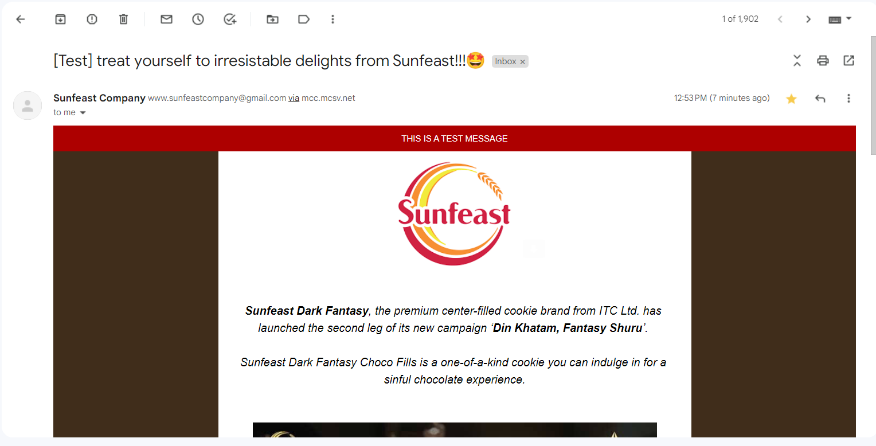
Part 4: Content Creation and Curation (Post creations, Designs/Video Editing, Ad Campaigns over Social Media and Email Ideation and Creation)
Email Ad Campaigns
Ad Campaigns for email marketing:
Two email campaigns were created using the Mailchimp website-one for lead generation and the other for brand awareness. These campaigns were then sent via Gmail.
Each email was molded with team ideas and the most challenging aspect while creating the email was the limitations of the free version of Mailchimp website.

Slide 29
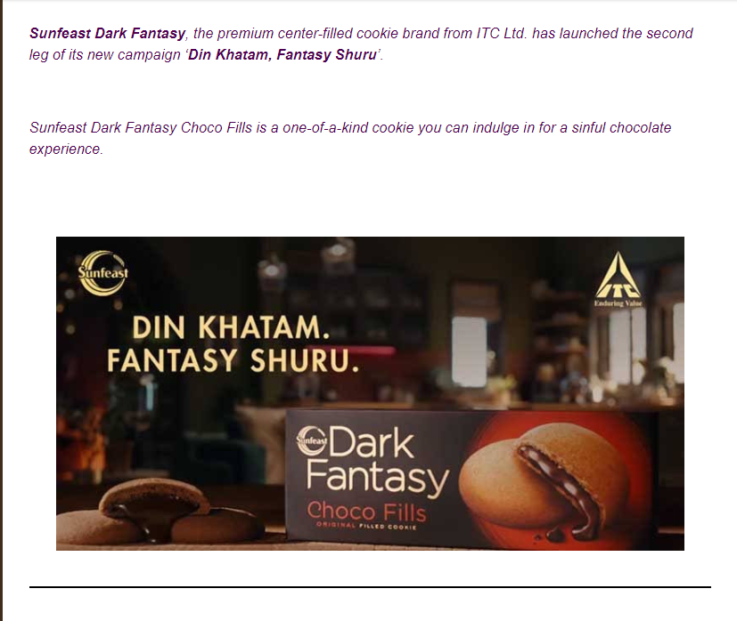
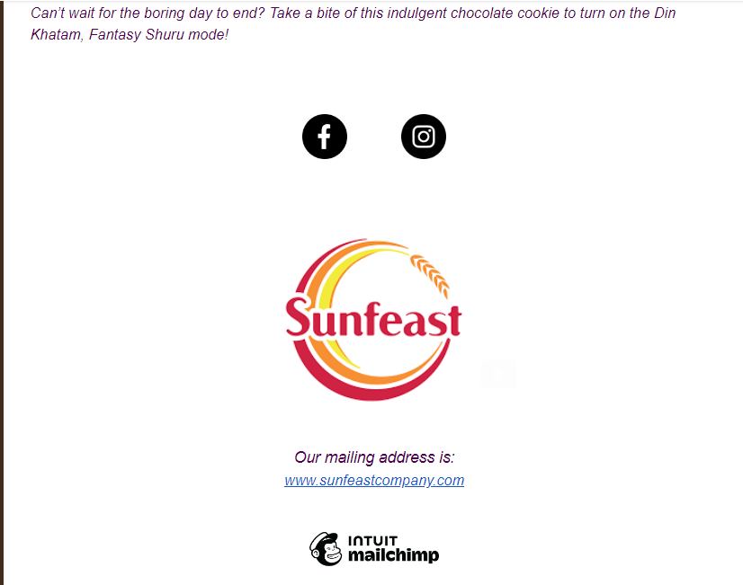
Email Ad Campaign 1 - Brand Awareness
The Mailchimp website is used for creating email campaigns.
Our email prominently highlights the introduction of Sunfeast company’s new campaign which is
“Din Khatam, Fantasy Shuru”.
The main motive of this campaign which is lauched by Sunfeast Company – Dark Fantasy is to spread awareness about the campaign and the new packaging of the product ‘Sunfeast- Dark Fantasy”.
The social media links of facebook and Instagram were attached along with the Sunfeast original website link.
Facebook: Click Here
Instagram: Click Here

Slide 30
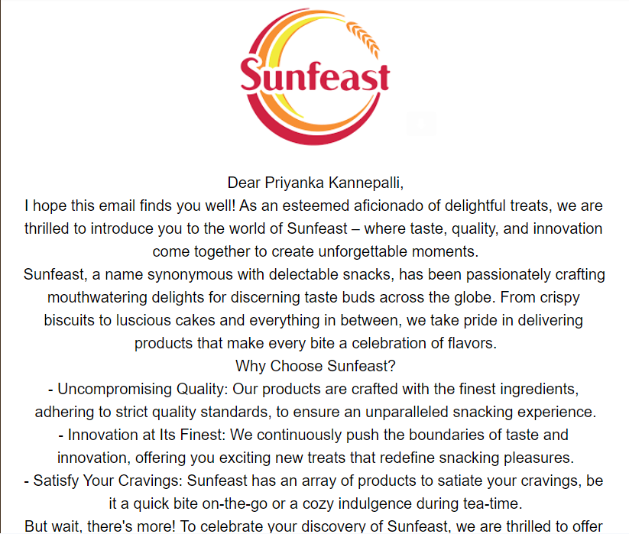
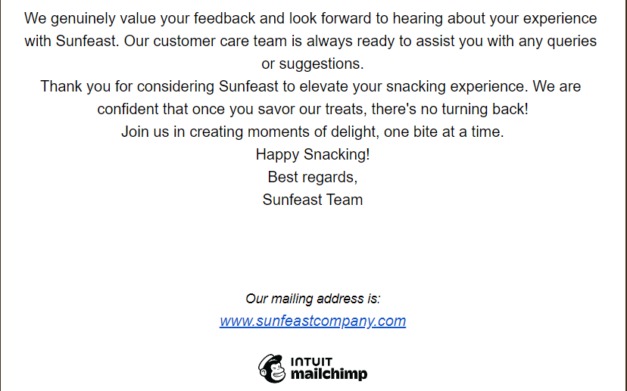
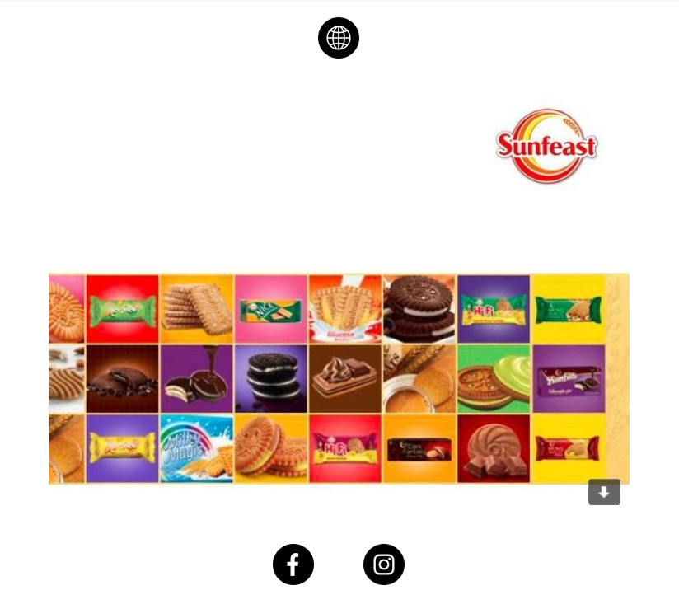
Email Ad Campaign 2 - Lead Generation
This was the second email which we have created for lead generation purpose.
Through this email ad campaign, we could reach a large number of audience directly, increasing the chances of engagement and interaction.
Compared to traditional marketing, this method is cost effective.
Regular email communication helps build and maintain relations with customers.

Slide 31
Part 4: Content Creation and Curation (Post creations, Designs/Video
Editing, Ad Campaigns over Social Media and Email Ideation and Creation)
Lessons learned:
Effective and efficient understanding and managing of different websites.
Proper control and monitoring of online content in an organised manner.
Regular feedback and continuous efforts for the success of social media ad campaign.
Challenges faced:
Limited access to tools in websites as they were not available for free.
Less availability of information and content available online which was the most challenging part.
The email test campaign through the third party websites was unfamiliar which made it difficult to get the output.

